Slide 1

PROJECT SPOTLIGHT / CYBERSECURITY + AI
DigitalGhost
2.1.1
Detecting dormant identities with dangerous retained access
An AI-driven behavioral identity decay & privilege-risk intelligence system
ABHISHEK VISHWAKARMA • SANCHITA WARKAD • PULKIT YADAV
Guided by Mrs. Shilpa Mathur | TCET • AIML • AY 2026–27
DIGITALGHOST 2.1.1 • PROJECT-BASED LEARNING

Slide 2
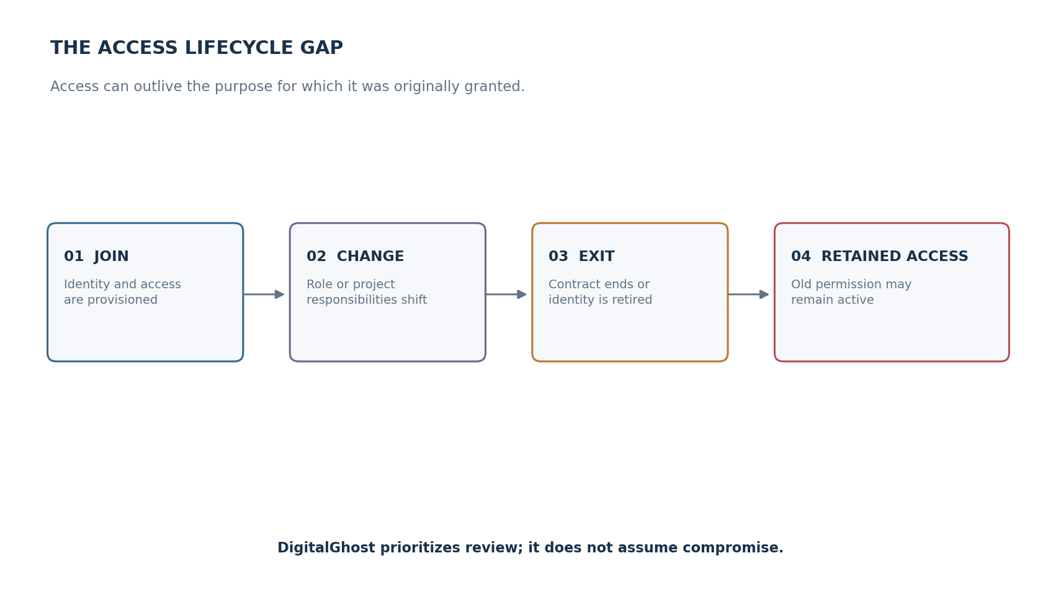
01 / THE PROBLEM
Access can outlive the reason it was granted
The risk is not just an inactive account — it is an identity whose access no longer matches its purpose.
THE BLIND SPOT
Role changes.
Projects end.
Contracts expire.
Yet permissions may remain active — creating exposure that periodic reviews can miss.
DIGITALGHOST 2.1.1 • PROJECT-BASED LEARNING
02

Slide 3
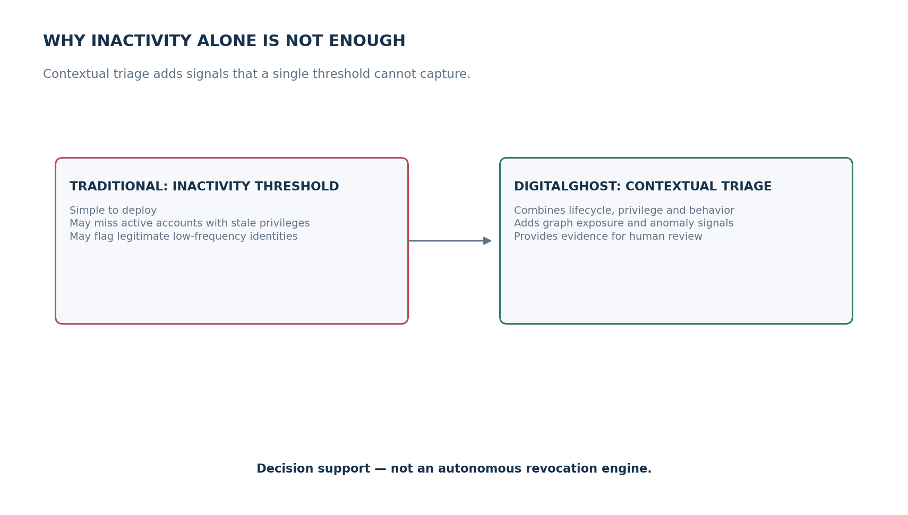
02 / WHY EXISTING CHECKS MISS CONTEXT
Inactivity is a signal — not a verdict
A useful triage system must understand what an identity can access, not only when it last logged in.
THE DESIGN PRINCIPLE
Context over cut-offs
Different identity types behave differently
Active accounts can still hold stale privileges
Every finding needs evidence and human review
DIGITALGHOST 2.1.1 • PROJECT-BASED LEARNING
03

Slide 4
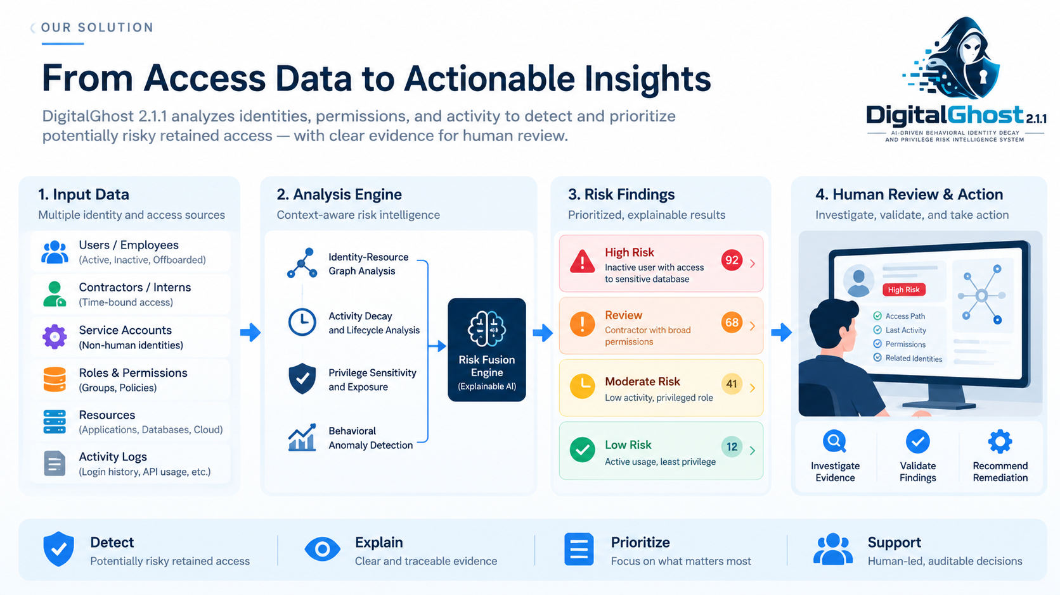

Slide 5
03 / THE SOLUTION
DigitalGhost turns scattered signals into a review queue
A local-first decision-support prototype for identity and privilege risk triage.
01
02
03
MODEL CONTEXT
COMBINE SIGNALS
EXPLAIN & REVIEW
Identity lifecycle • permission use
resource sensitivity • ownership
Rule-based checks • graph exposure
Isolation Forest anomaly signal
Priority band • evidence summary
read-only investigation • audit trail
BOUNDARY
DigitalGhost recommends investigation; it does not autonomously disable accounts or prove malicious intent.
DIGITALGHOST 2.1.1 • PROJECT-BASED LEARNING
04

Slide 6
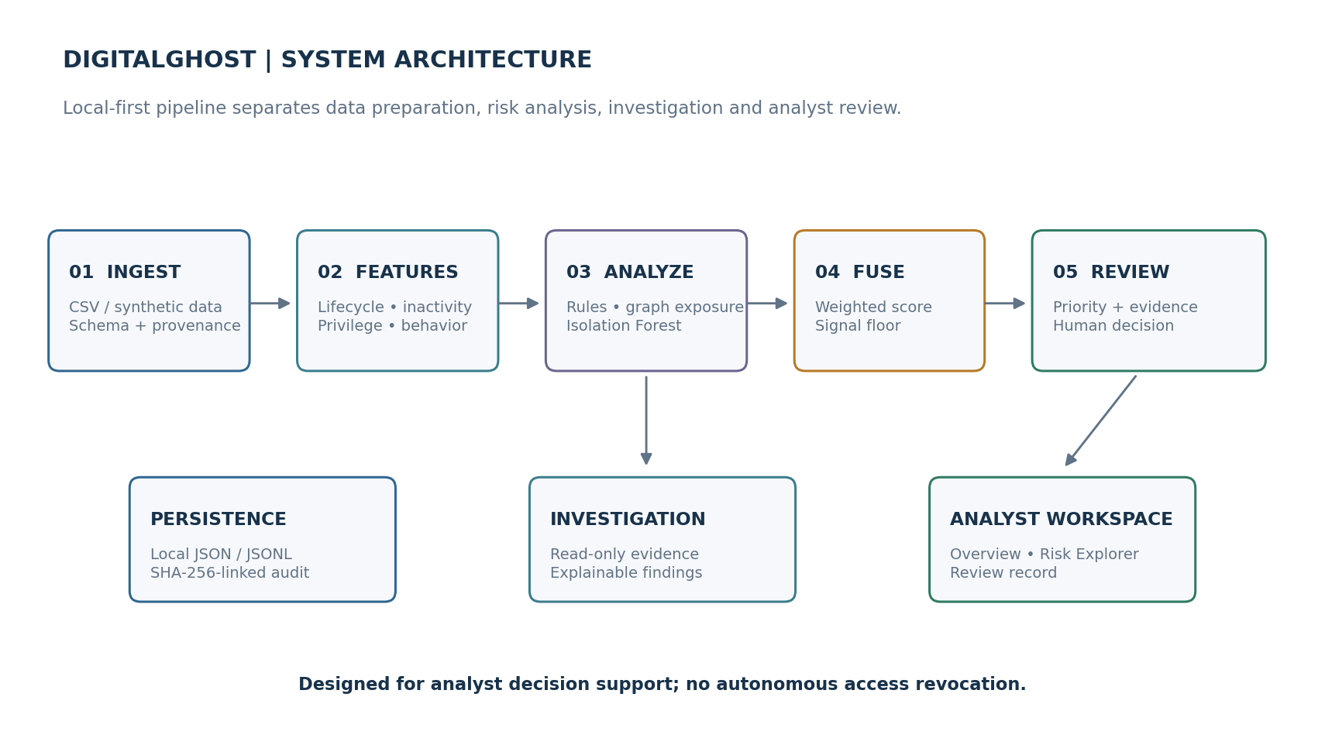
04 / SYSTEM DESIGN
A modular, local-first analysis pipeline
The architecture keeps data preparation, scoring, investigation, and review responsibilities distinct.
DIGITALGHOST 2.1.1 • PROJECT-BASED LEARNING
05

Slide 7
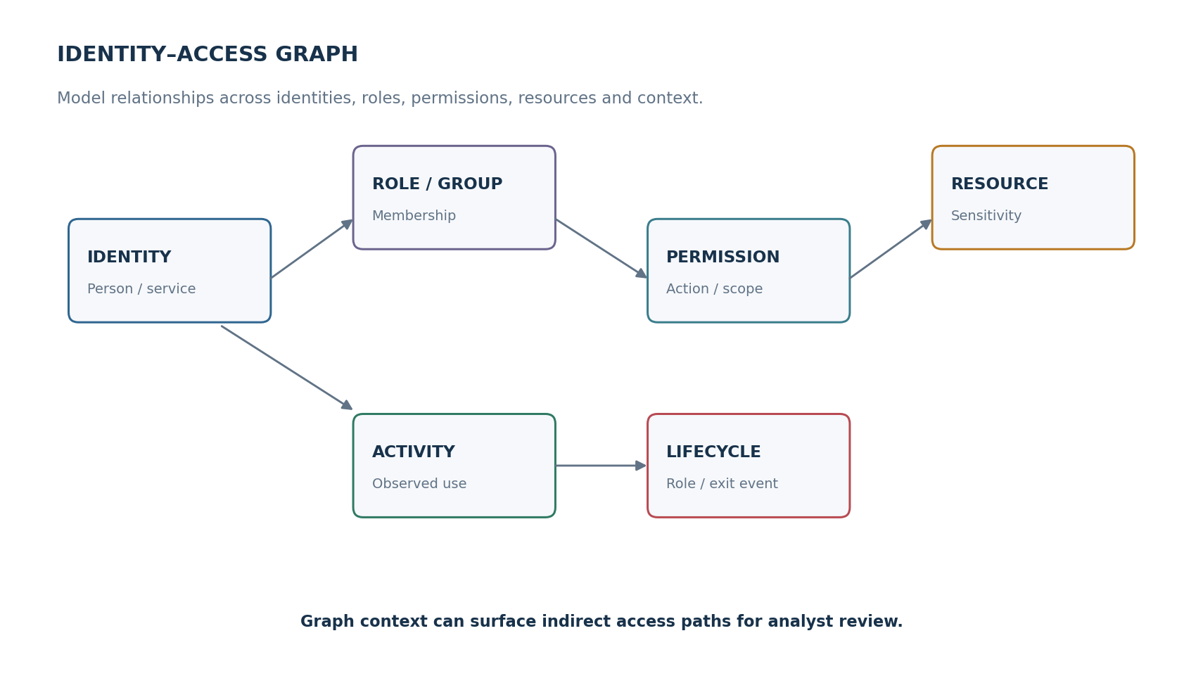
05 / GRAPH CONTEXT
Access is a network of relationships
Graph analysis helps connect an identity to roles, permissions, resources, activity, and lifecycle context.
WHAT THE GRAPH ADDS
Surfaces indirect or inherited access paths
Links permissions to resource sensitivity
Adds context beyond last-login timestamps
Keeps a traceable path for review
DIGITALGHOST 2.1.1 • PROJECT-BASED LEARNING
06

Slide 8
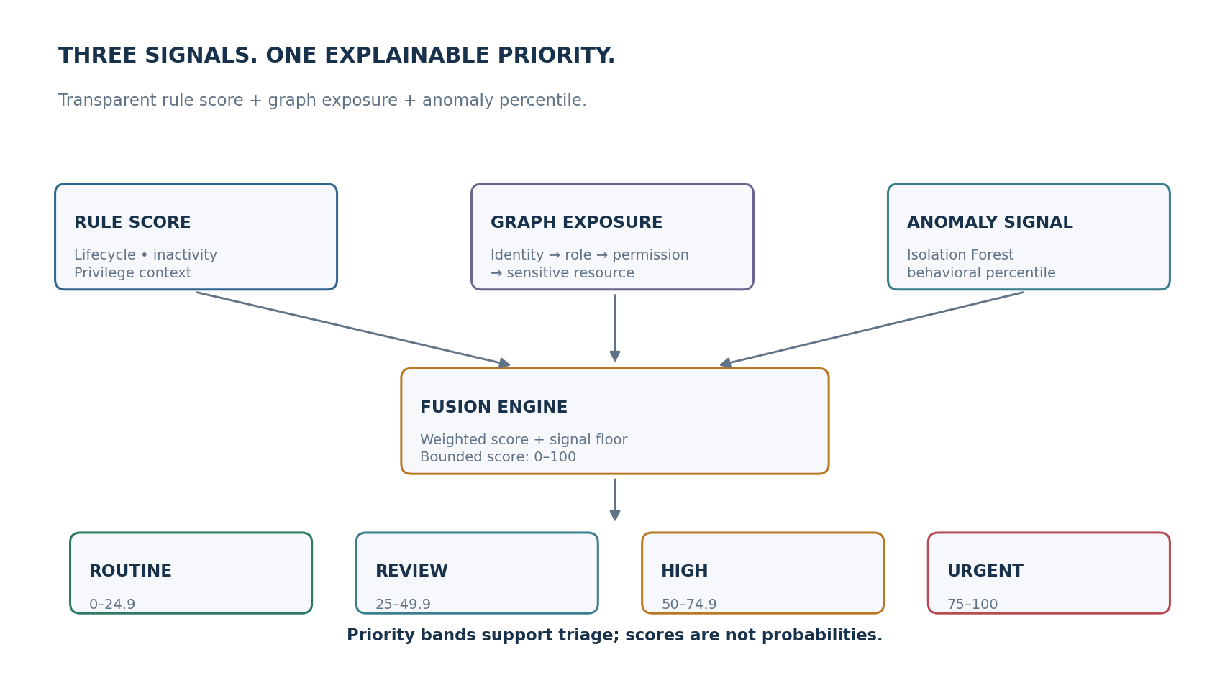
06 / RISK INTELLIGENCE
Three perspectives. One explainable priority.
Score fusion is designed to avoid allowing one strong signal to disappear inside an average.
DIGITALGHOST 2.1.1 • PROJECT-BASED LEARNING
07

Slide 9
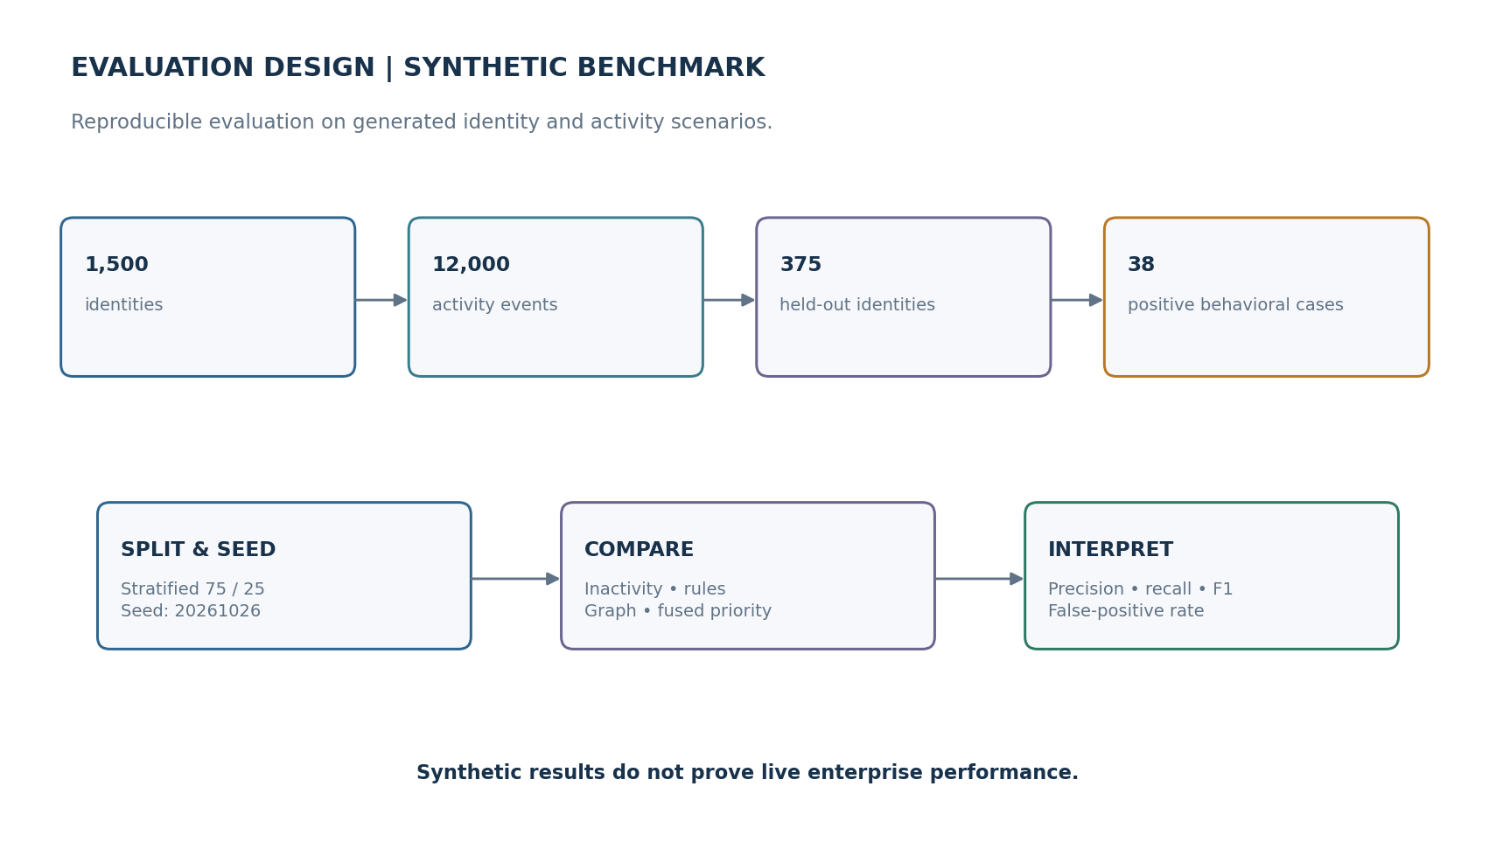
07 / EVIDENCE & EVALUATION
A reproducible synthetic benchmark
The report evaluates the approach on generated identity and activity scenarios; results should not be generalized to live enterprise systems.
REPORTED TEST EVIDENCE
18 / 18
automated tests passed
Synthetic benchmark: 1,500 identities • 12,000 activity events • 375 held-out identities
DIGITALGHOST 2.1.1 • PROJECT-BASED LEARNING
08

Slide 10
08 / RESULTS & INTERPRETATION
Use metrics to guide review — not to claim certainty
Benchmark metrics describe performance on the supplied synthetic scenarios, not on production identity estates.
Isolation Forest
F1 0.747
Rule Engine
F1 0.575
Anomaly-oriented signal
Transparent baseline
Graph Risk
F1 0.477
Fused Priority
F1 0.688
Relationship exposure
Combined triage signal
Interpretation: no single detector dominates every scenario; fused scoring broadens triage coverage, with trade-offs.
Metrics transcribed from the provided report snapshot; verify against the final benchmark output before presenting.
DIGITALGHOST 2.1.1 • PROJECT-BASED LEARNING
09

Slide 11
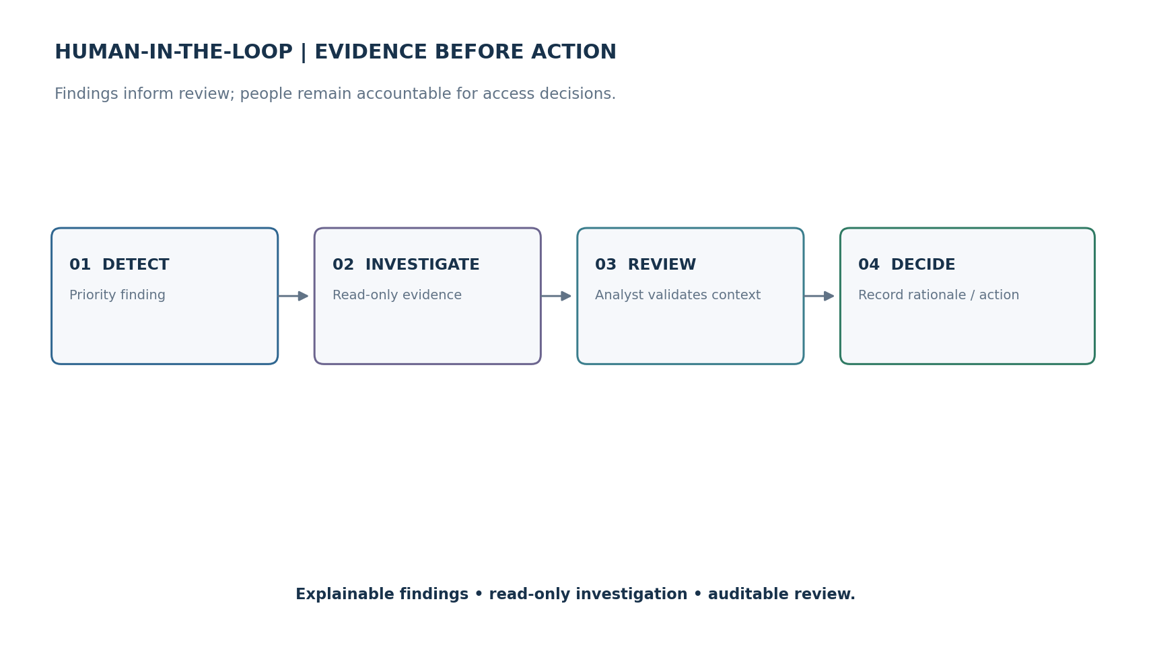
09 / RESPONSIBLE USE
Human review is the control plane
Explainability, read-only investigation, and auditability are central to the proposed workflow.
GUARDRAILS
No autonomous access revocation
Anomaly ≠ compromise
Evidence accompanies findings
Analyst records the decision
Synthetic-data limits are explicit
DIGITALGHOST 2.1.1 • PROJECT-BASED LEARNING
10

Slide 12
10 / NEXT STEPS
From research prototype to validated pilot
The next phase should focus on validation, explainability, and controlled integration — not premature automation.
01
02
03
04
VALIDATE
EXPLAIN
INTEGRATE
GOVERN
Test against expert-labelled cases
Measure false positives / negatives
Add feature-level evidence
Run ablation and calibration studies
Use sanitized, approved data
Keep permissions read-only initially
Privacy review • access controls
Human approval • auditability
Success means a more accurate, explainable access-review queue — with accountable decisions.
DIGITALGHOST 2.1.1 • PROJECT-BASED LEARNING
11

Slide 13
THE TAKEAWAY
The danger isn't only
who can log in.
It's what they can
still reach.
DigitalGhost makes retained access visible, explainable, and reviewable.
QUESTIONS / DISCUSSION
Abhishek Vishwakarma • Sanchita Warkad • Pulkit Yadav
DIGITALGHOST 2.1.1 • PROJECT-BASED LEARNING

